Slide 1
Probability & Random Processes EE2011 Department of Electrical Engineering
NATIONAL UNIVERSITY OF COMPUTER & EMERGING SCIENCES, LAHORE CAMPUS

Slide 2


Slide 3



Slide 4




Slide 7




Slide 8









Slide 9
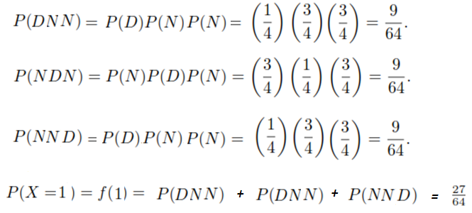
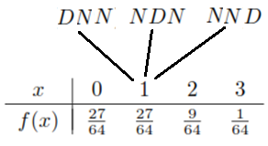

Slide 10
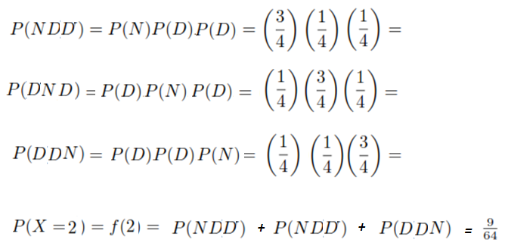
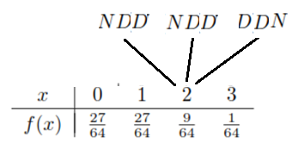

Slide 11



Slide 12




Slide 13


Slide 14


Slide 15




Slide 17




Slide 18


Slide 19






Slide 20
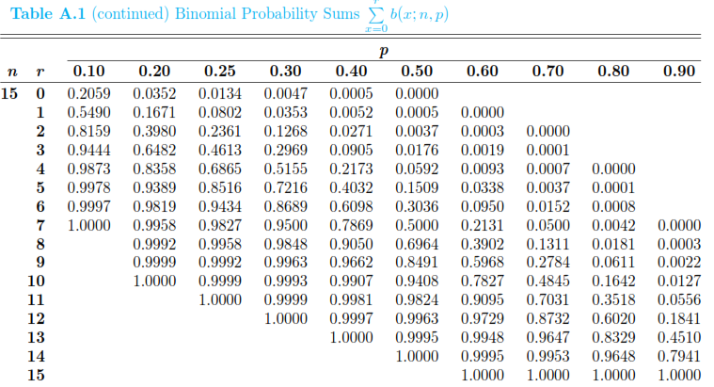

Slide 21
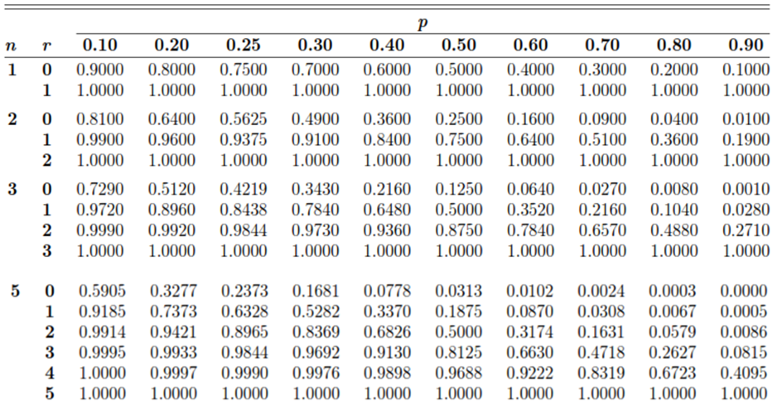

Slide 22




Slide 24





Slide 25




Slide 27


Slide 28



Slide 30



Slide 31





Slide 32
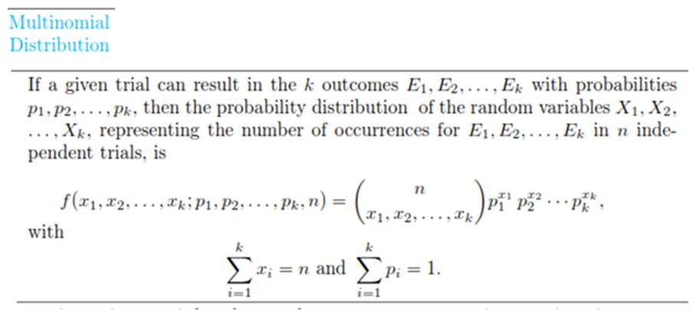


Slide 33






